Slide 1


Air Quality Prediction in Urban Areas
Using AI to Forecast and Mitigate Urban Air Pollution

Slide 2
KALAISELVI K (TEAMLEADER_S4F_CP_TEAM_11931)
SURUTHIKA DEVI M (TEAM MEMBER_S4F_CP_TEAM_11931)
KAVIYA S (TEAM MEMBER_S4F_CP_TEAM_11931)
MALAVIKA D (TEAM MEMBER_S4F_CP_TEAM_11931)

Slide 3
Content
Abstract
Problem Statement
Objective
Data Collection and Preparation
Proposed Solution (Methodology)
Model Performance Evaluation
Screenshots / Demonstration (video)
Future Scope
Conclusion

Slide 4
Abstract
Air pollution is a critical challenge in urban areas.
Accurate predictions help governments take early action.
Machine learning can forecast AQI using pollution, traffic, and weather data, enabling preventive public health responses.

Slide 5
Problem Statement
Urban air pollution causes serious health issues.
Traditional monitoring is sensor-limited and slow.
AI models can bridge this gap by analyzing environmental, traffic, and weather data to predict AQI levels in advance.

Slide 6
Objective
Use ML to predict AQI 24 hours in advance.
Identify key features affecting AQI.
Integrate predictions with urban traffic systems.
Support early warning systems.

Slide 7
Data Collection and Preparation
3 years of data:
• Air Quality: PM2.5, PM10, NO2, CO.
• Traffic data.
• Weather: temperature, humidity, wind.
Preprocessing:
• Handle missing values.
• Feature scaling.
• Time-series transformations.

Slide 8
Proposed Solution (Methodology)
Exploratory Data Analysis (EDA).
Feature Selection.
Model Selection (Random Forest, XGBoost, LSTM).
Train-test split & validation.
Performance evaluation.
Deployment for real-time predictions.

Slide 9
Model Performance Evaluation
Metrics : RMSE, MAE, R2 Score
LSTM : Best for time-series, RMSE = 14.8
XGBoost : High accuracy, RMSE = 15.3
Random Forest : Interpretable, RMSE = 16.2

Slide 10
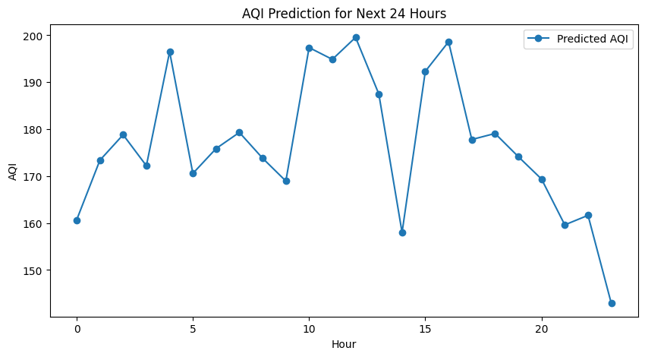
Screenshots / Demonstration (video)
Github Link : https://github.com/Suruthikadevi/Air-Quality-Prediction-in-Urban-Areas/upload/main

Slide 11
Future Scope
IoT sensor network integration.
Forecast AQI up to 7 days ahead.
Personalized health risk alerts.
Policy simulation tools for city planning.
Public engagement via mobile apps.

Slide 12
Case study: 4 Question and Answer
How can machine learning models be used to predict air quality levels?
Machine learning models predict air quality by analyzing historical sensor data, meteorological factors, and traffic conditions. These models learn patterns in pollution levels based on various environmental factors and provide future AQI forecasts.
Common approaches include:

Slide 13
Regression Models (Random Forest, XGBoost) – Predict continuous AQI values.
Time-Series Models (LSTM, ARIMA) – Forecast AQI trends over time.
Deep Learning Models (CNNs, Transformers) – Handle complex spatial-temporal relationships in air pollution data. By leveraging real-time data, ML models enable authorities to issue early warnings and take preventive actions.

Slide 14
2. Which features in the dataset are likely to have the most significant impact on air quality?
key factors influencing air quality include:
PM2.5 & PM10 – Fine particulate matter, primary indicators of pollution.
NO2 & CO – Traffic-related pollutants affecting AQI.
Temperature & Humidity – Affect pollutant dispersion and concentration.
Wind Speed – Higher speeds disperse pollutants, lowering AQI.
Traffic Density – Increased traffic contributes to higher emissions. Feature importance analysis using techniques like SHAP values or Random Forest feature importance can identify the most influential variables in AQI prediction.

Slide 15
3. Build a model to predict AQI for the next 24 hours.
We can use a Random Forest Regressor for AQI prediction:
from sklearn.ensemble import RandomForestRegressor
from sklearn.model_selection import train_test_split
from sklearn.metrics import mean_squared_error
import pandas as pd
# Load dataset
data = pd.read_csv("air_quality_data.csv")
# Define features and target
features = ["PM2.5", "PM10", "NO2", "CO", "temperature", "humidity", "wind_speed", "traffic_density"]
target = "AQI"

Slide 16
# Handle missing values
data = data.dropna()
# Train-test split
X_train, X_test, y_train, y_test = train_test_split(data[features], data[target], test_size=0.2,
random_state=42)
# Train model
model = RandomForestRegressor(n_estimators=100, random_state=42)
model.fit(X_train, y_train)
# Predict for next 24 hours (assuming new data is available)
future_predictions = model.predict(X_test[:24])
# Print predicted AQI values
print(f"Predicted AQI for next 24 hours: {future_predictions}")

Slide 17
4. How can this model be integrated with a city's traffic management system to reduce pollution?
The AQI prediction model can be integrated with traffic management through:
Dynamic Traffic Control: Restrict high-emission vehicles in areas with predicted high pollution.
Smart Traffic Signals: Adjust signal timings to reduce congestion and emissions.
Public Transport Recommendations: Encourage commuters to use buses/trains on high-pollution days.
Industry Regulations: Alert industries to reduce emissions when pollution is forecast to rise.Cities can implement AI-driven "green corridors" and real-time adaptive traffic control systems to mitigate pollution.

Slide 18
5. Discuss the role of AI in mitigating air pollution in developing countries.
AI plays a crucial role in monitoring, predicting, and mitigating air pollution in developing nations by: ✅ Low-Cost Air Quality Monitoring: AI-driven sensors provide real-time pollution data. ✅ Early Warnings & Alerts: AI forecasts help governments take proactive actions. ✅ Policy Optimization: AI assists in formulating data-driven environmental policies. ✅ Smart Mobility Solutions: AI-driven public transport scheduling reduces traffic emissions. ✅ Industrial Emission Control: AI models detect and regulate excessive industrial pollution.

Slide 19
Conclusion
AI-powered models can predict AQI with high accuracy, allowing cities to act early.
By combining environmental, traffic, and weather data, these systems can inform the public and reduce exposure to harmful air.

